Slide 1
Introduction to Computational Thermodynamics
Section 2.4
Statistical Association Fluid Theory

Slide 2
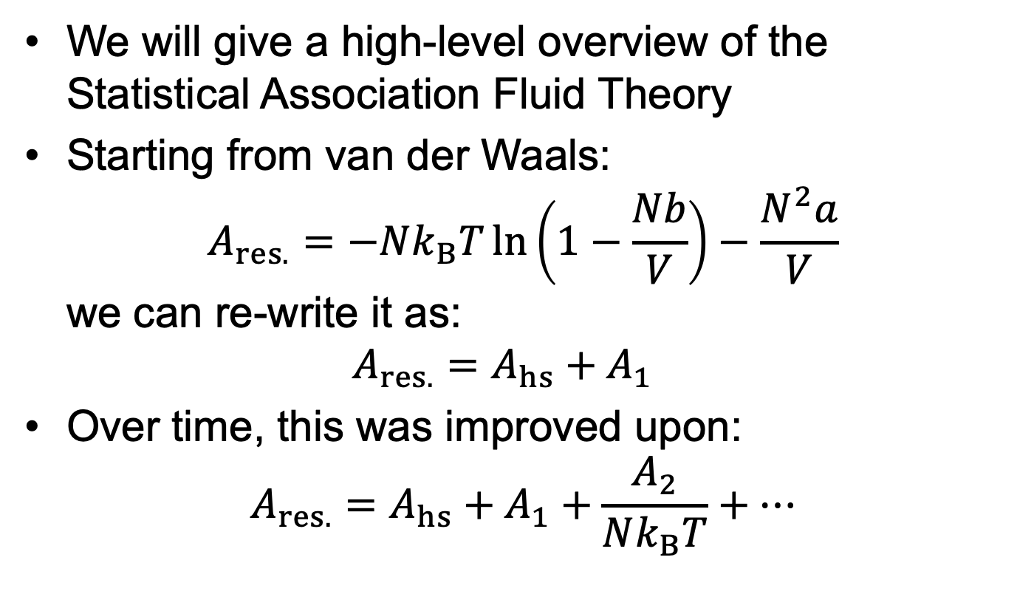
Introduction
We will give a high-level overview of the Statistical Association Fluid Theory
Starting from van der Waals: $A_{res.}=−Nk_{B}T\ln\left(1−\frac{Nb}{V}\right)−\frac{N^{2}a}{V}$ we can re-write it as: $A_{res.}=A_{hs}+A_{1}$
Over time, this was improved upon: $A_{res.}=A_{hs}+A_{1}+\frac{A_{2}}{Nk_{B}T}+…$

Slide 3
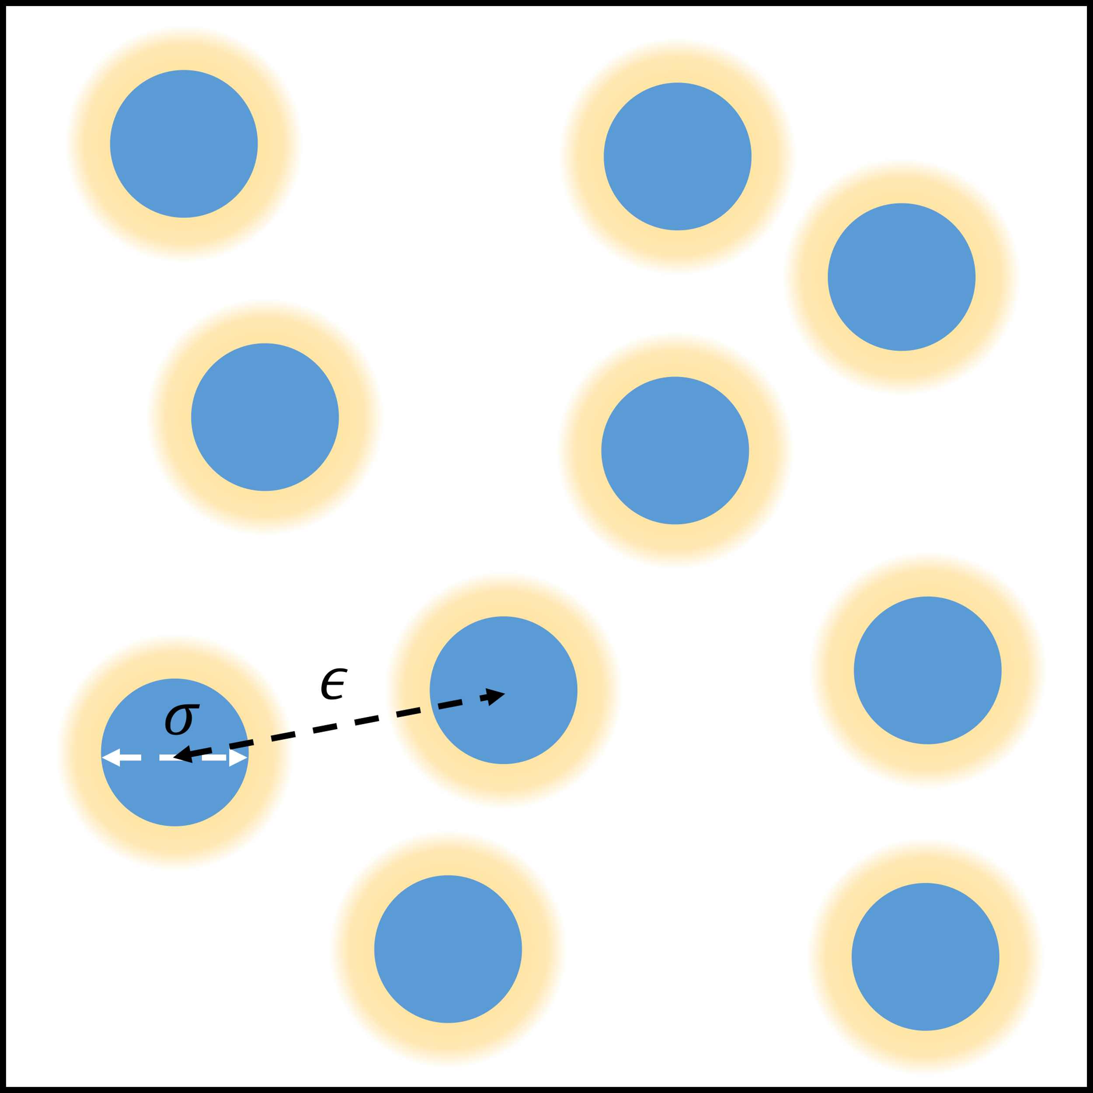
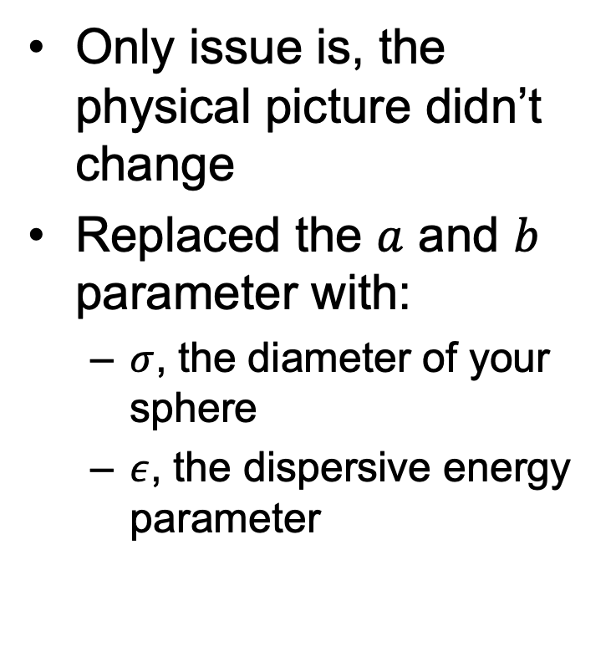
Introduction
Only issue is, the physical picture didn’t change
Replaced the $a$ and $b$ parameter with:
$σ$, the diameter of your sphere
$ε$, the dispersive energy parameter

Slide 4
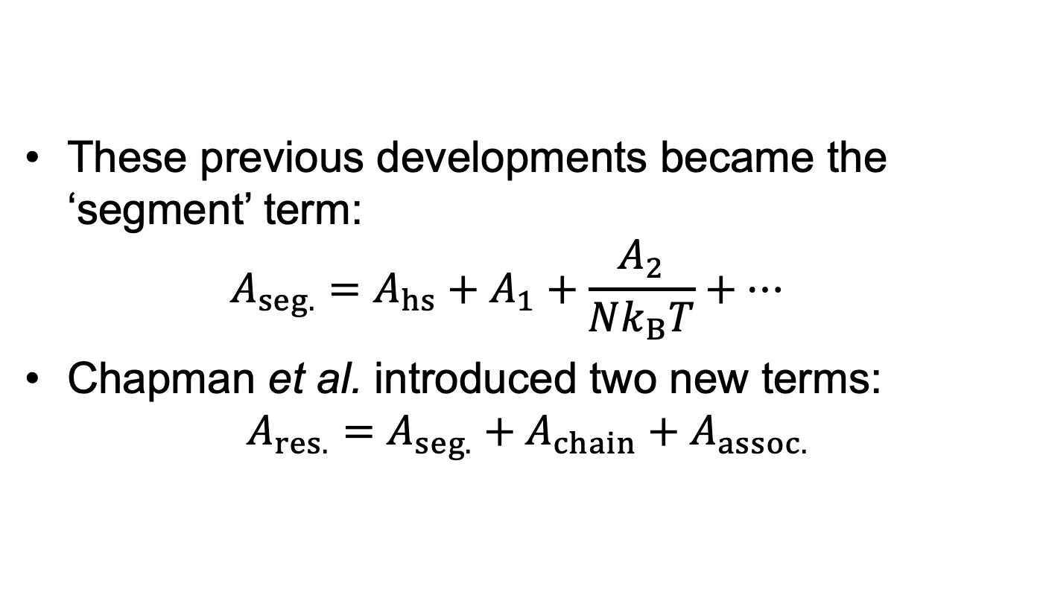
SAFT
These previous developments became the ‘segment’ term: $A_{seg.}=A_{hs}+A_{1}+\frac{A_{2}}{Nk_{B}T}+…$
Chapman et al. introduced two new terms: $A_{res.}=A_{seg.}+A_{chain}+A_{assoc.}$

Slide 5
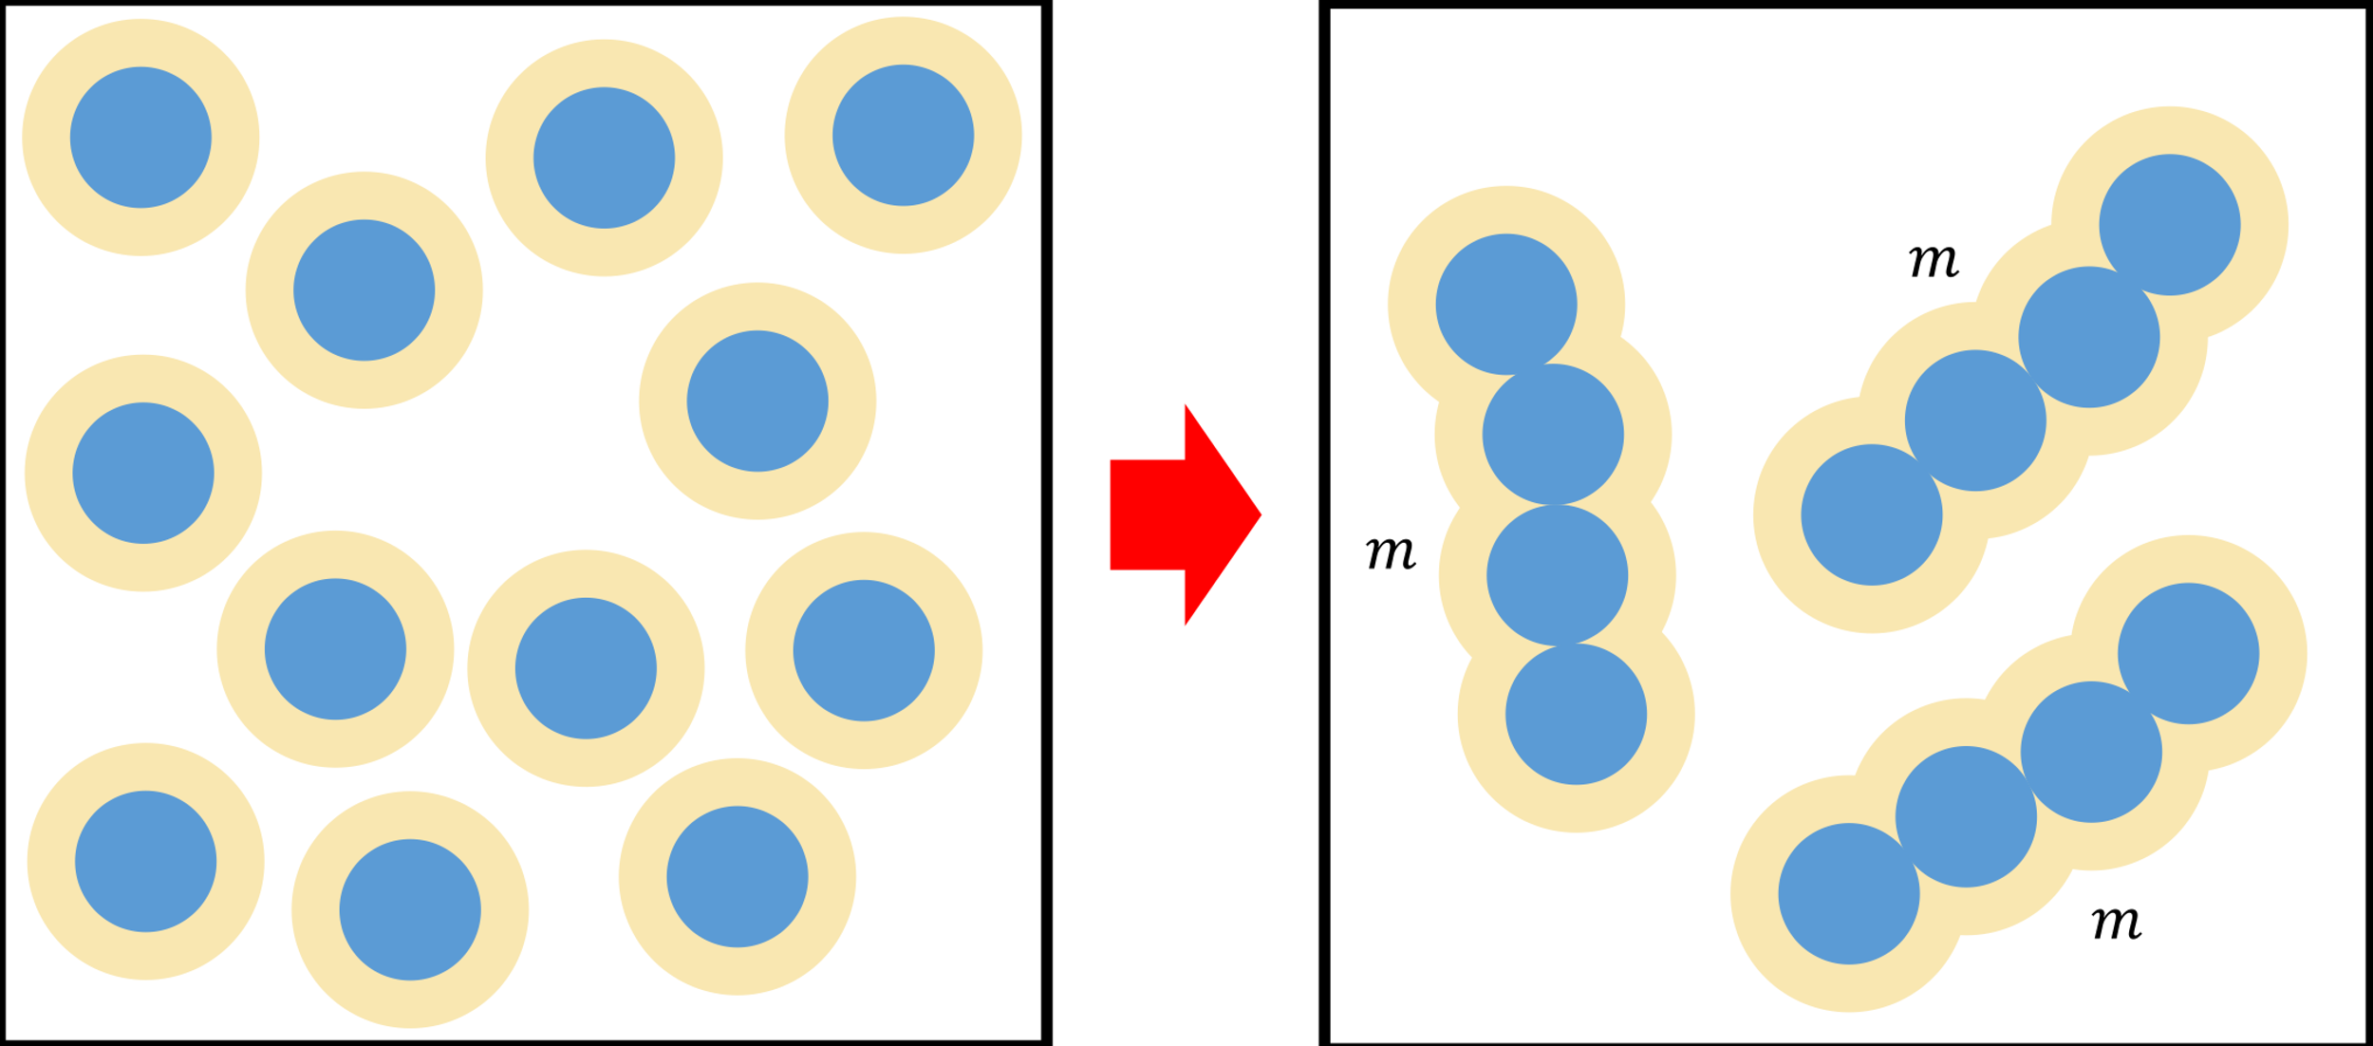

Chain term
The chain term takes the segments and assembles them into chains of length $m$:
$m$ doesn’t represent the number of monomers and doesn’t need to be an integer

Slide 6
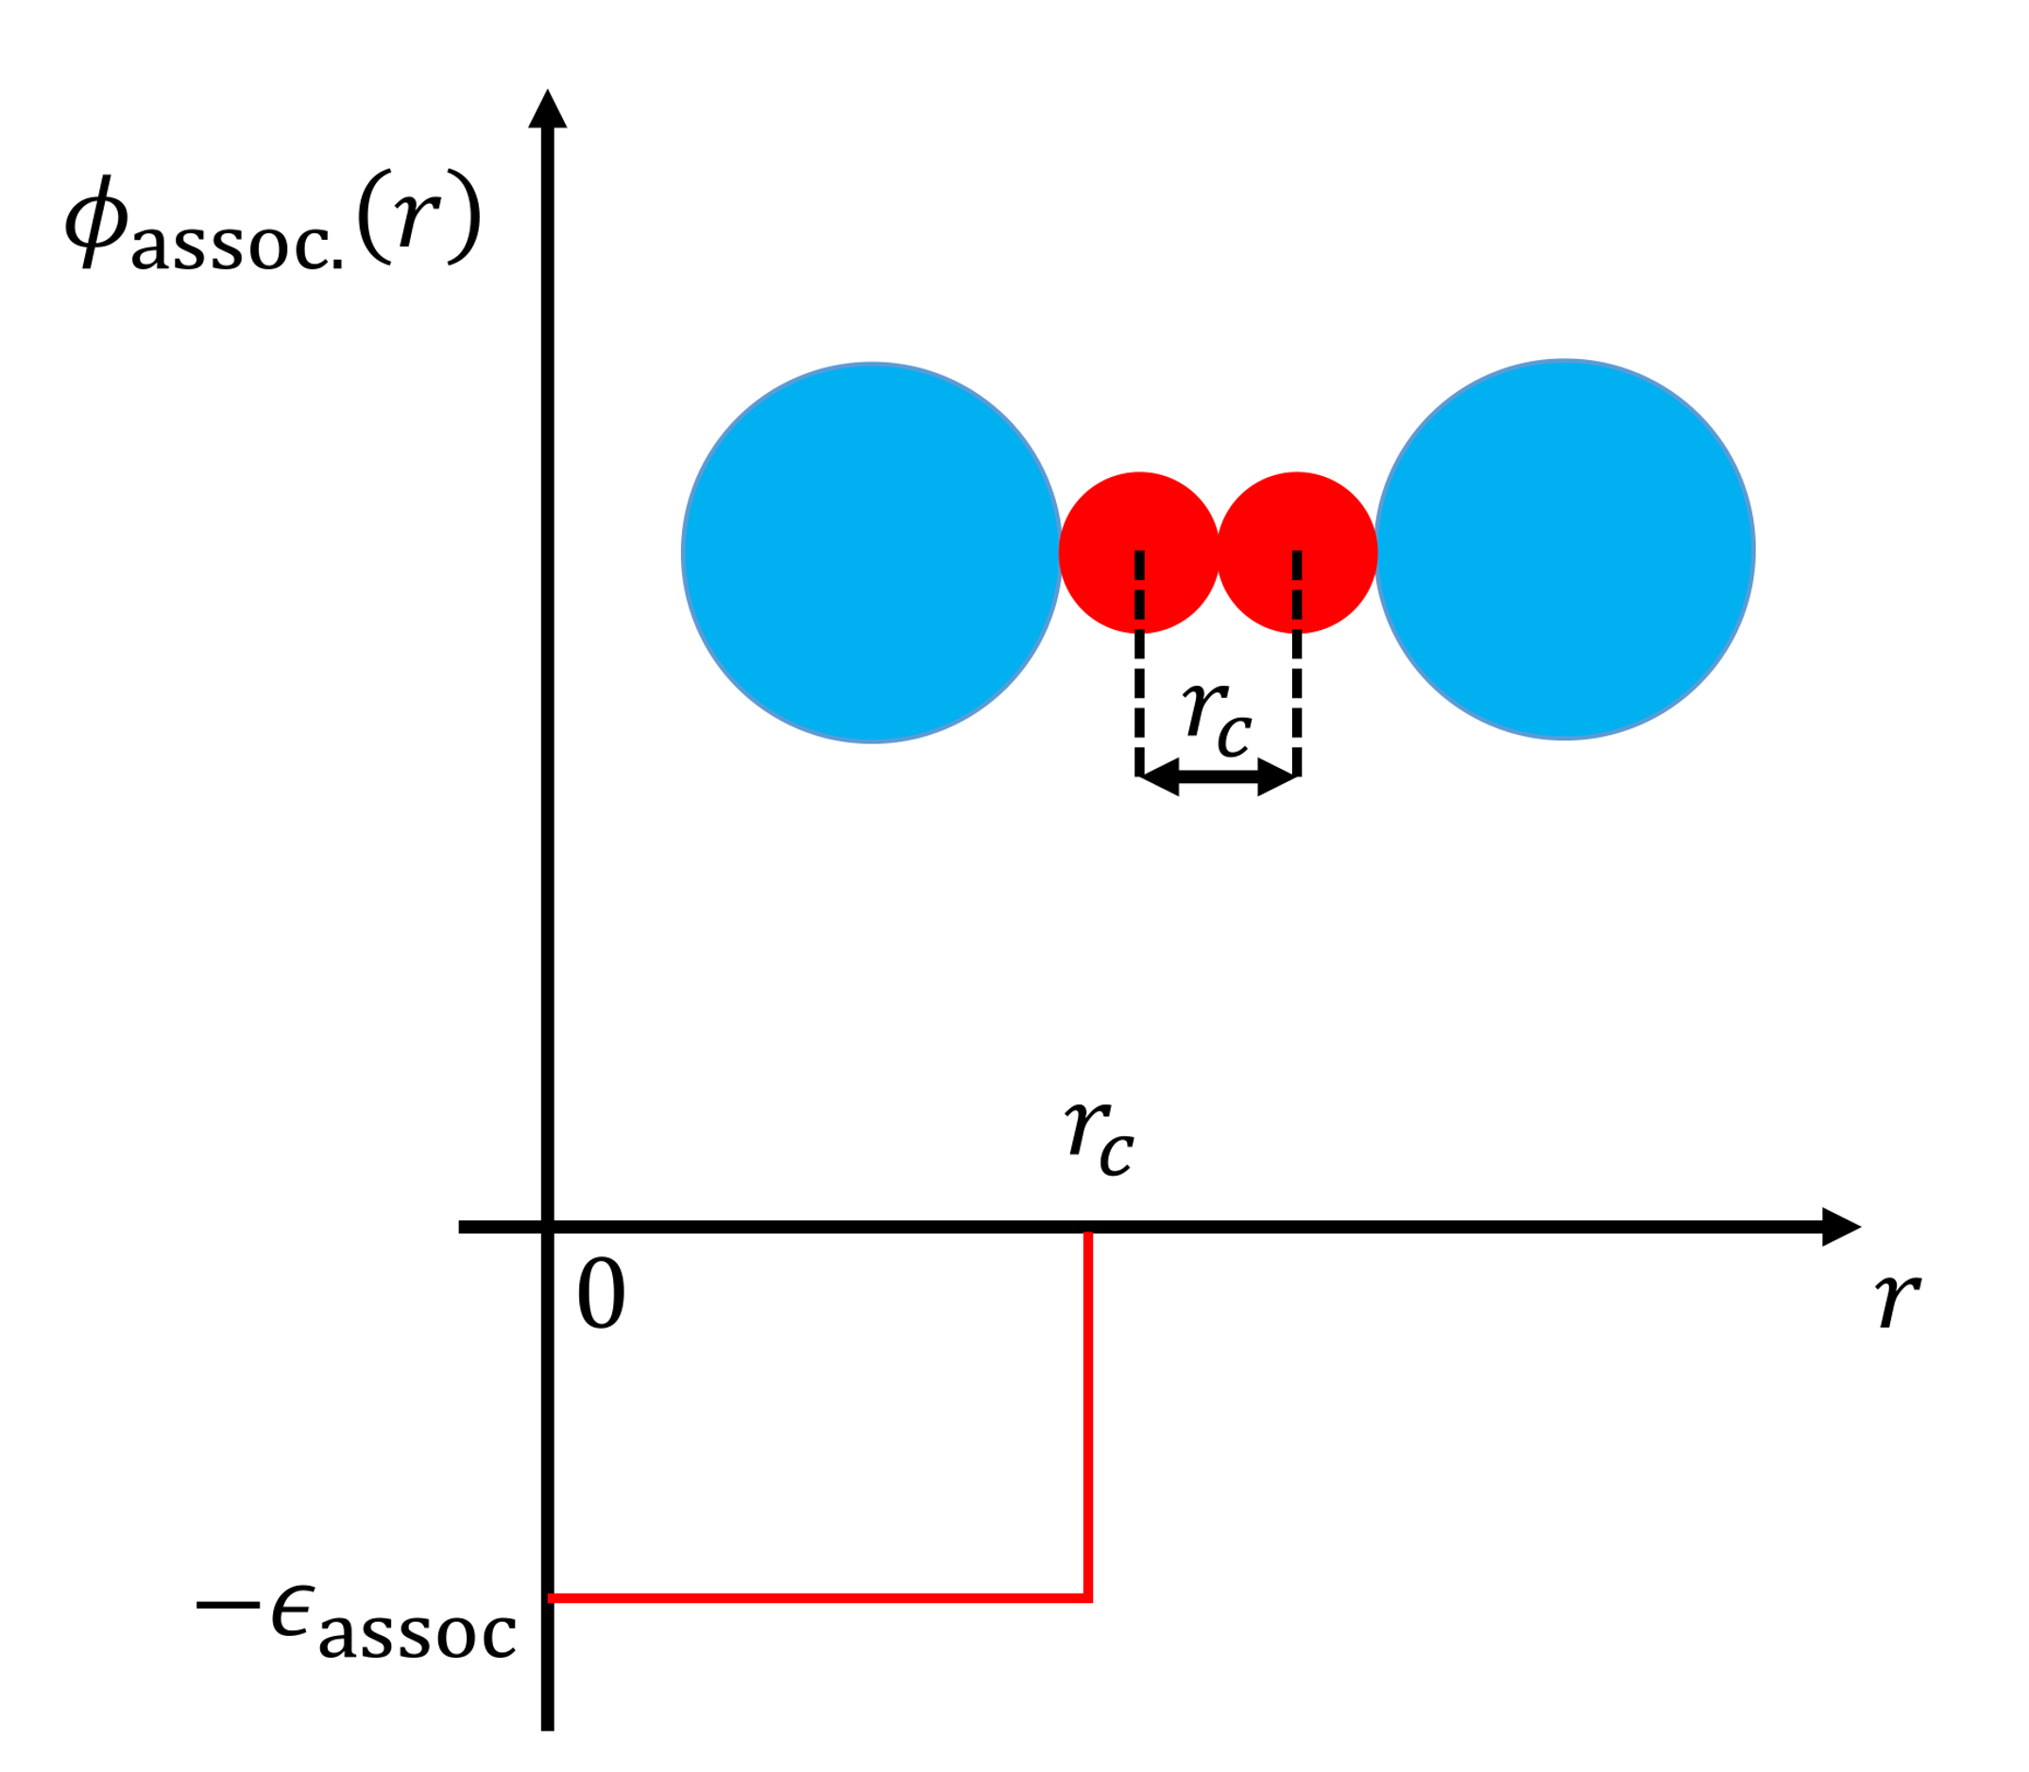
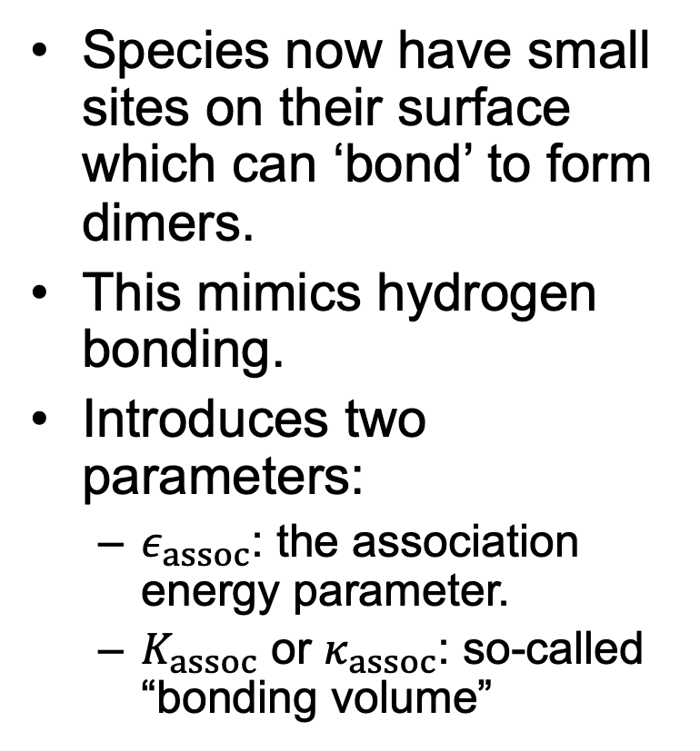
Association term
Species now have small sites on their surface which can ‘bond’ to form dimers.
This mimics hydrogen bonding.
Introduces two parameters:
$ε_{assoc}$: the association energy parameter.
$K_{assoc}$ or $κ_{assoc}$: so-called “bonding volume”

Slide 7
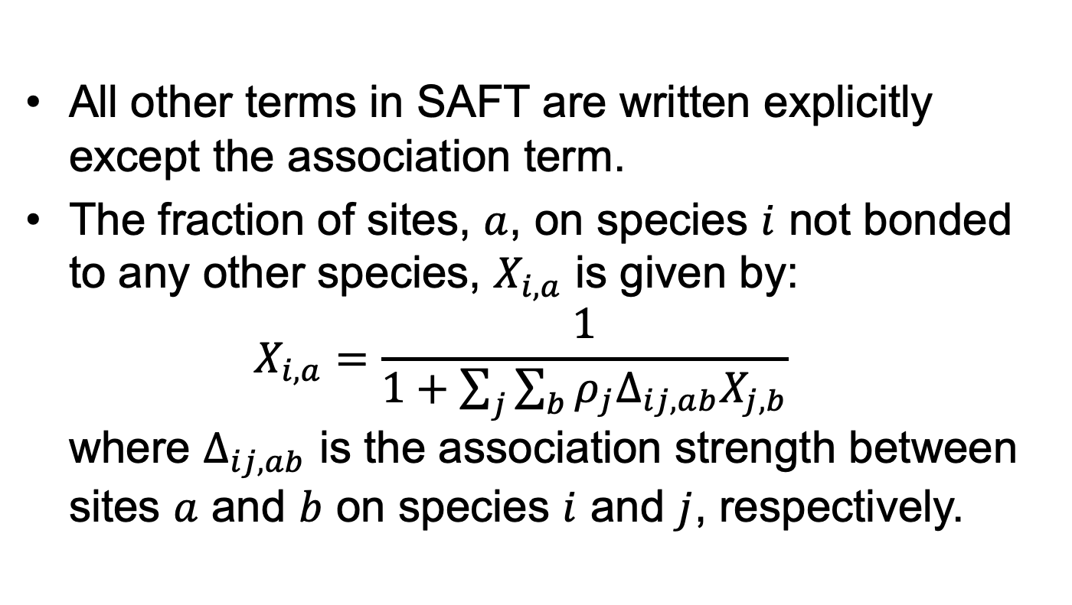
Association term
All other terms in SAFT are written explicitly except the association term.
The fraction of sites, $a$, on species $i$ not bonded to any other species, $X_{i,a}$ is given by: $X_{i,a}=\frac{1}{1+\sum_{j}{\sum_{b}{ρ_{j}Δ_{ij,ab}X_{j,b}}}}$ where $Δ_{ij,ab}$ is the association strength between sites $a$ and $b$ on species $i$ and $j$, respectively.

Slide 8
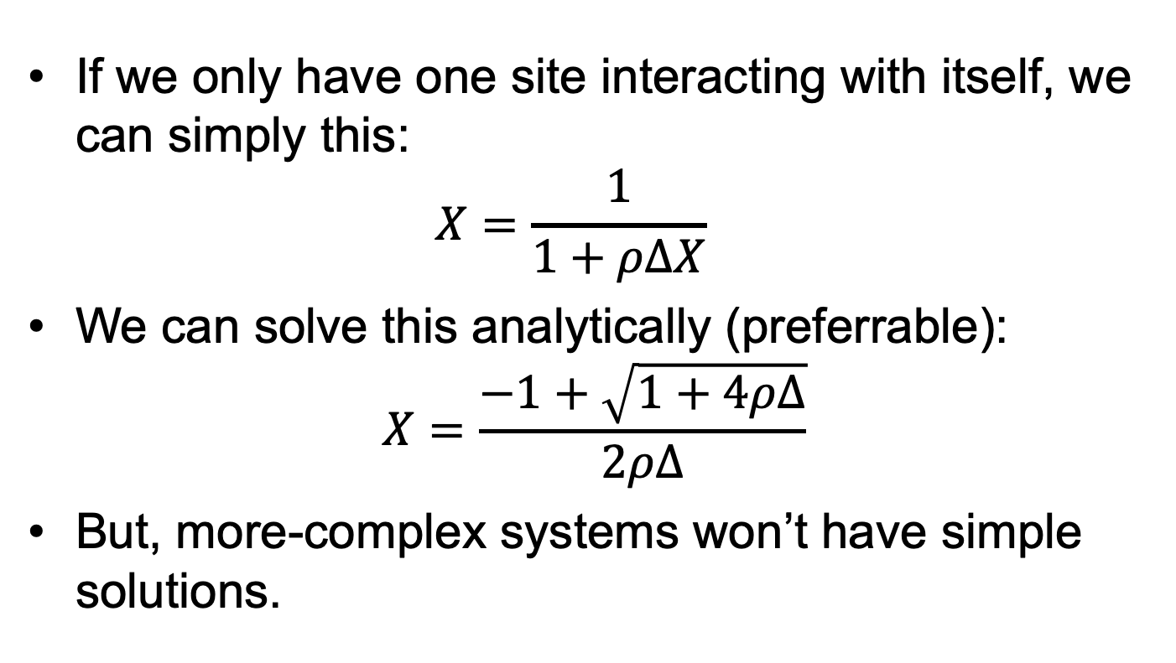
Association term
If we only have one site interacting with itself, we can simply this: $X=\frac{1}{1+ρΔX}$
We can solve this analytically (preferrable): $X=\frac{−1+\sqrt{1+4ρΔ}}{2ρΔ}$
But, more-complex systems won’t have simple solutions.

Slide 9

Association term
Simple method to solve it numerically: successive substitution $X^{\left(i+1\right)}=f\left(X^{\left(i\right)}\right)$ until: $\left|X^{\left(i+1\right)}−X^{\left(i\right)}\right|≤tol$
Switch to notebook and show “live” implementation

Slide 10

Association term
To improve the convergence, we can ‘damp’ the substitution: $X^{\left(i+1\right)}=αX^{\left(i\right)}+\left(1−α\right)f\left(X^{\left(i\right)}\right)$
Optimal value of $α$ is usually 0.5
Alternative methods do exist.
Switch to notebook and show “live” implementation

Slide 11
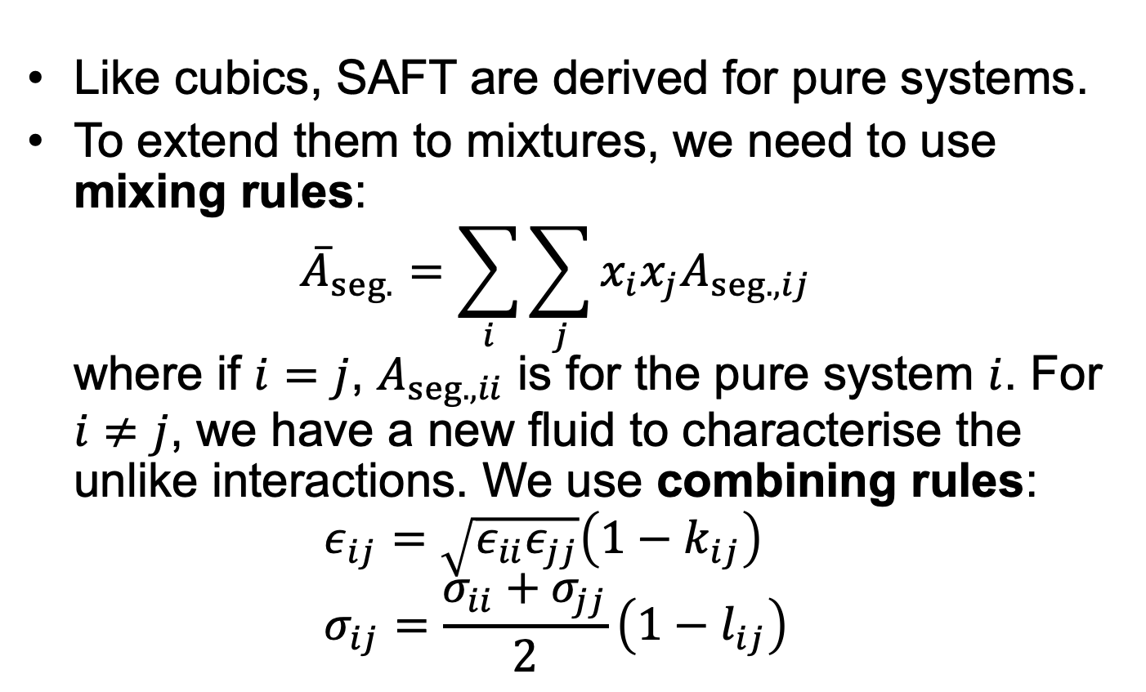
Mixtures
Like cubics, SAFT are derived for pure systems.
To extend them to mixtures, we need to use mixing rules: ${\overline{A}}_{seg.}=\sum_{i}{\sum_{j}{x_{i}x_{j}A_{seg.,ij}}}$ where if $i=j$, $A_{seg.,ii}$ is for the pure system $i$. For $i≠j$, we have a new fluid to characterise the unlike interactions. We use combining rules: $ε_{ij}=\sqrt{ε_{ii}ε_{jj}}\left(1−k_{ij}\right)$ $σ_{ij}=\frac{σ_{ii}+σ_{jj}}{2}\left(1−l_{ij}\right)$

Slide 12
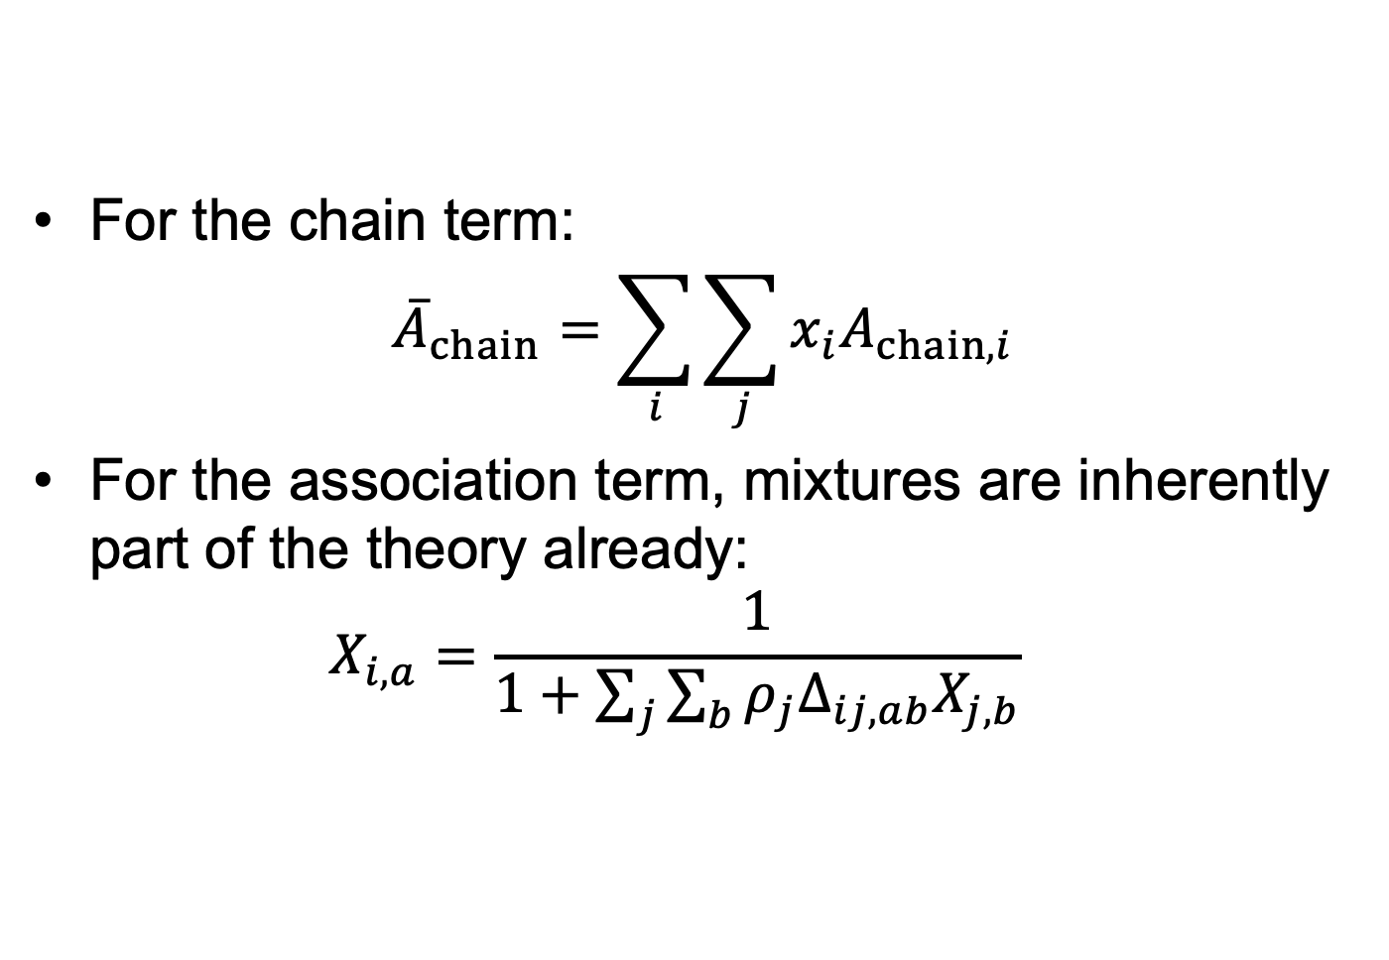
Mixtures
For the chain term: ${\overline{A}}_{chain}=\sum_{i}{\sum_{j}{x_{i}A_{chain,i}}}$
For the association term, mixtures are inherently part of the theory already: $X_{i,a}=\frac{1}{1+\sum_{j}{\sum_{b}{ρ_{j}Δ_{ij,ab}X_{j,b}}}}$

Slide 13
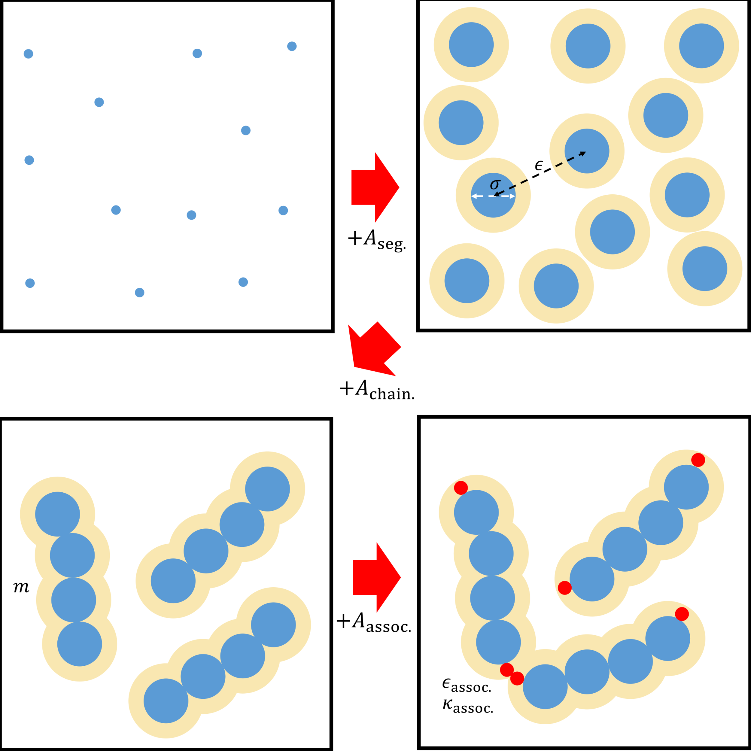
Summary:
Overall, SAFT can model chain-like species with association and dispersive interactions.
All parameters in SAFT must be fitted to experimental data.
Many different versions!

Slide 14
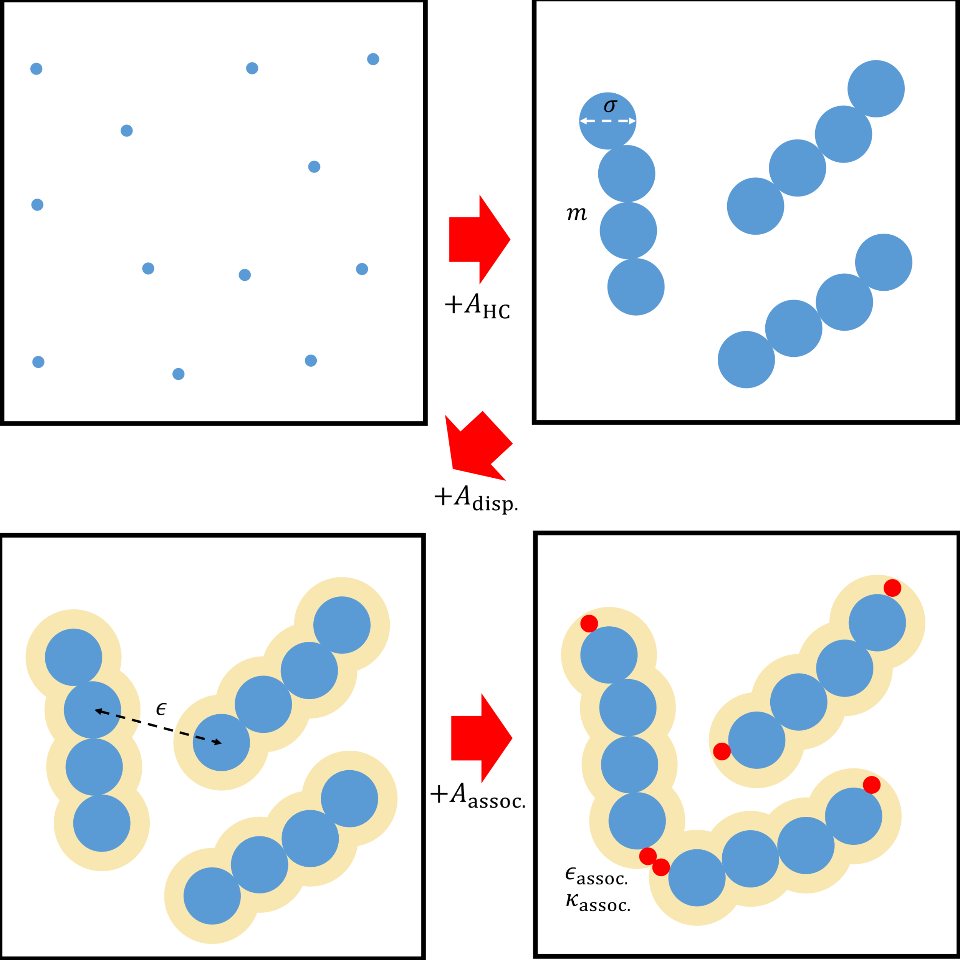
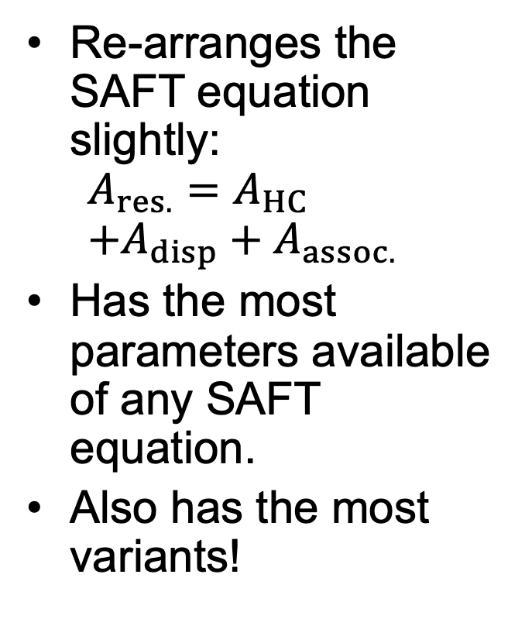
Perturbed-Chain SAFT
Re-arranges the SAFT equation slightly: $A_{res.}=A_{HC}$ $+A_{disp}+A_{assoc.}$
Has the most parameters available of any SAFT equation.
Also has the most variants!

Slide 15
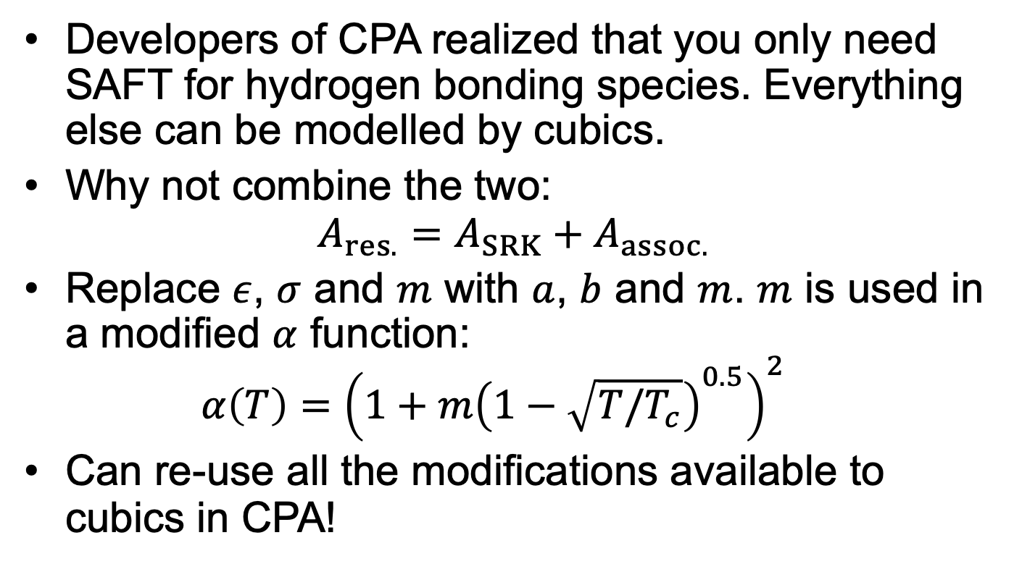
Cubic Plus Association
Developers of CPA realized that you only need SAFT for hydrogen bonding species. Everything else can be modelled by cubics.
Why not combine the two: $A_{res.}=A_{SRK}+A_{assoc.}$
Replace $ε$, $σ$ and $m$ with $a$, $b$ and $m$. $m$ is used in a modified $α$ function: $α\left(T\right)={\left(1+m{\left(1−\sqrt{T/T_{c}}\right)}^{0.5}\right)}^{2}$
Can re-use all the modifications available to cubics in CPA!

Slide 16
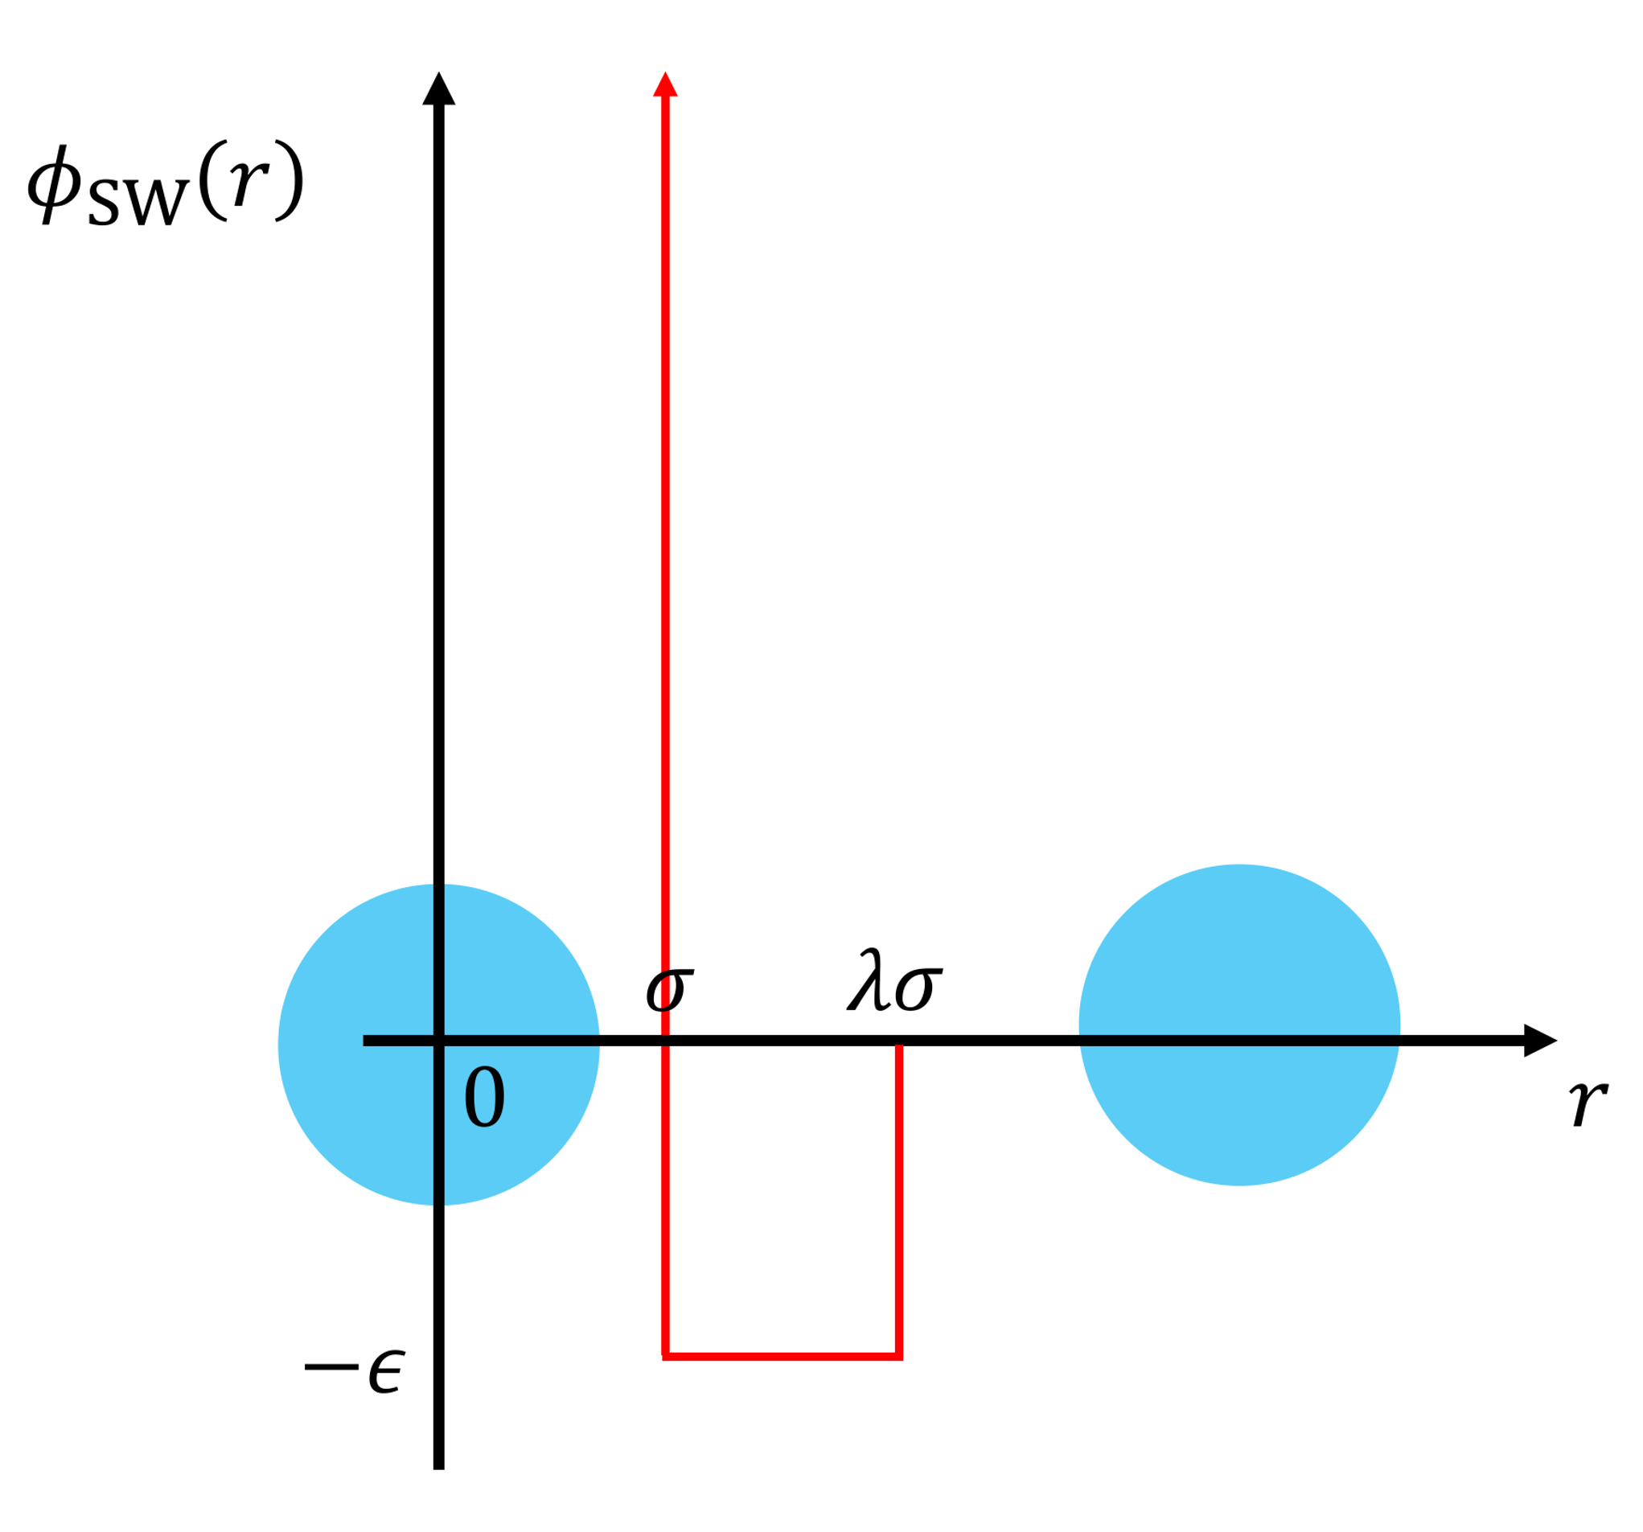
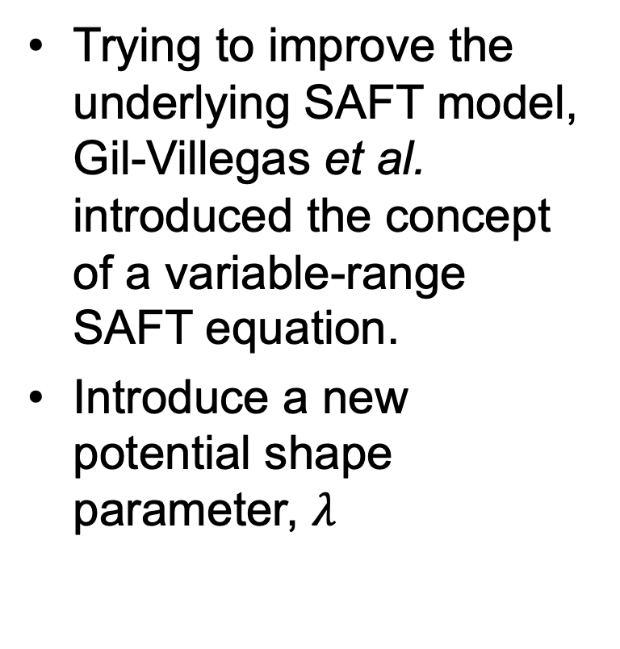
SAFT-VR Mie
Trying to improve the underlying SAFT model, Gil-Villegas et al. introduced the concept of a variable-range SAFT equation.
Introduce a new potential shape parameter, $λ$

Slide 17
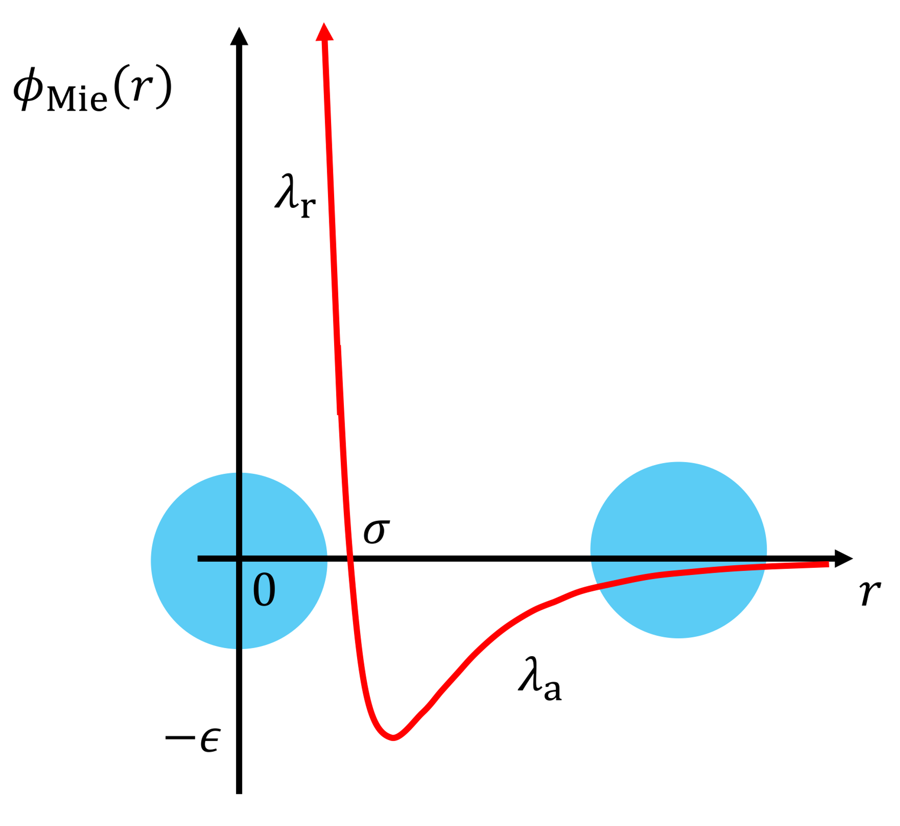
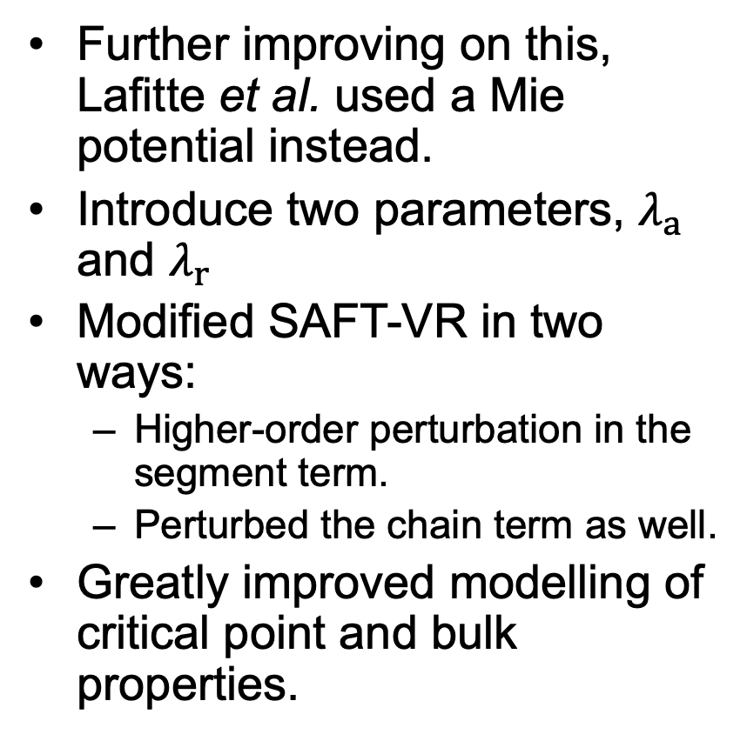
SAFT-VR Mie
Further improving on this, Lafitte et al. used a Mie potential instead.
Introduce two parameters, $λ_{a}$ and $λ_{r}$
Modified SAFT-VR in two ways:
Higher-order perturbation in the segment term.
Perturbed the chain term as well.
Greatly improved modelling of critical point and bulk properties.

Slide 18

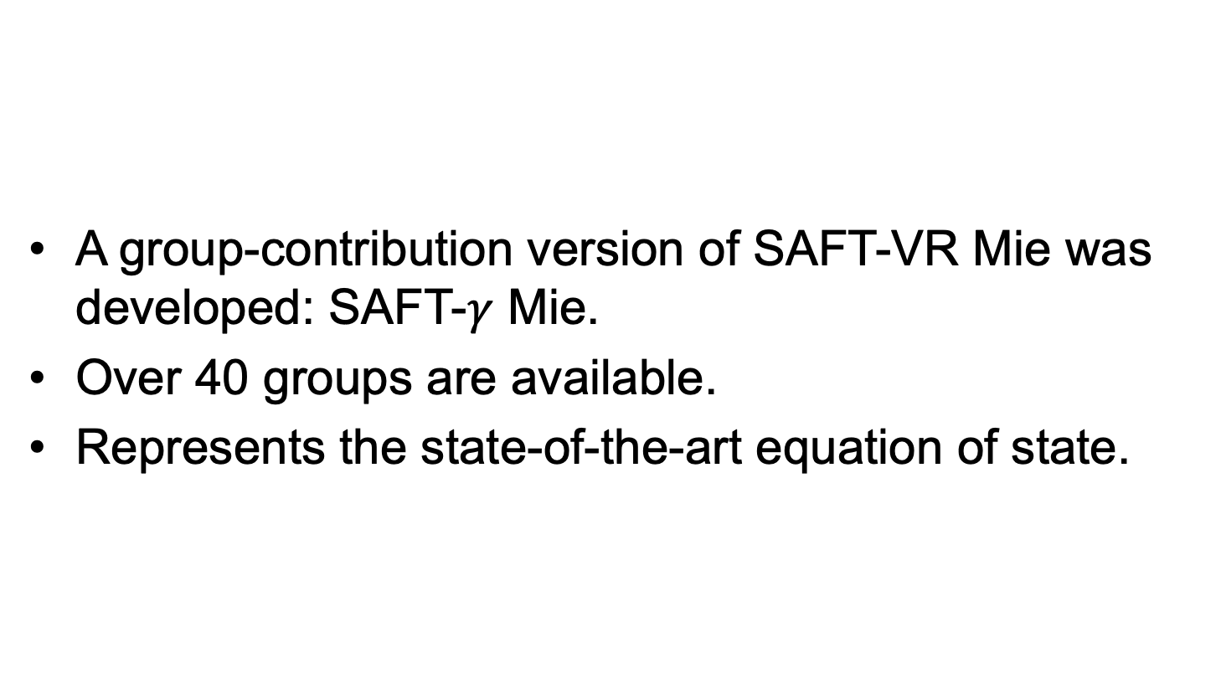
SAFT-$γ$ Mie
A group-contribution version of SAFT-VR Mie was developed: SAFT-$γ$ Mie.
Over 40 groups are available.
Represents the state-of-the-art equation of state.

Slide 19
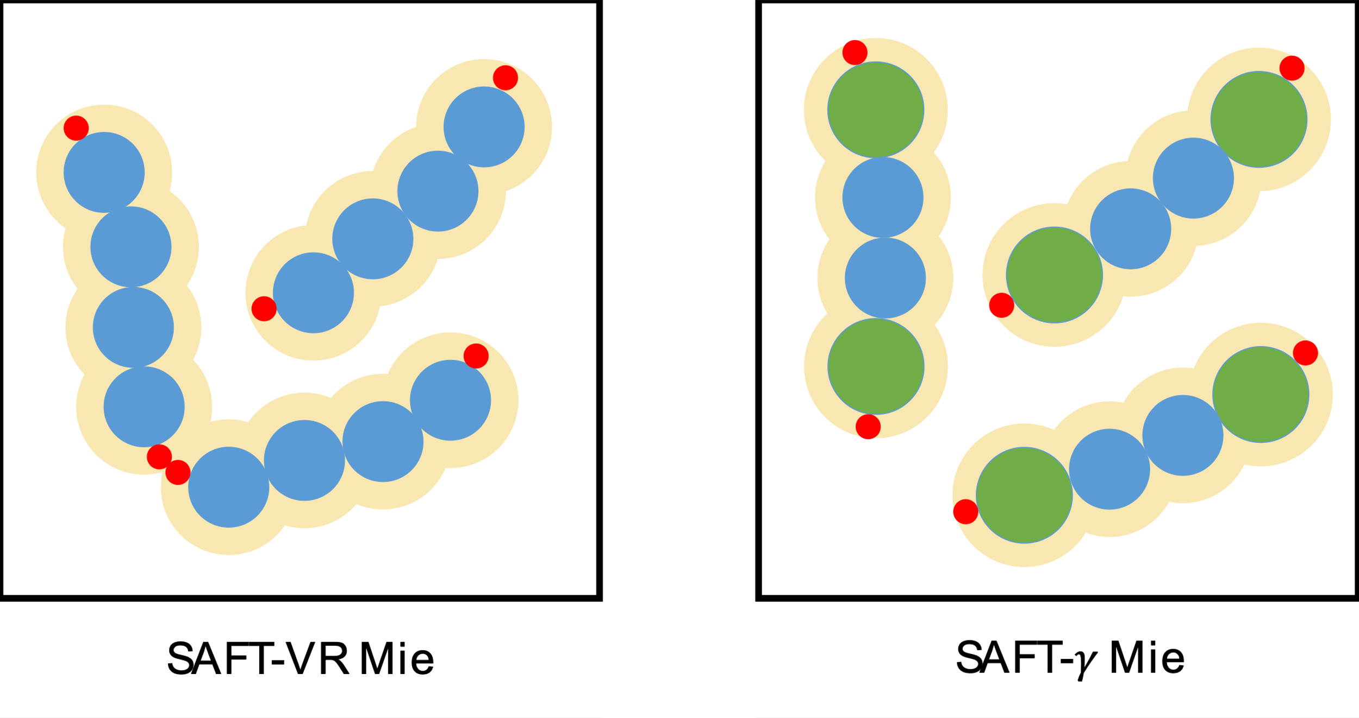
SAFT-$γ$ Mie
Because we now use groups, we can have heterosegmented chains:

Slide 20
Comparison
For most conditions, the various SAFTs are quite similar:

Slide 21
Comparison
The critical point can sometimes be important to predict correctly:

Slide 22
Comparison
For mixtures, it still comes down to fitted parameters:

Slide 23
Comparison
In terms of computational time:
Switch to notebook and show “live” implementation

Slide 24
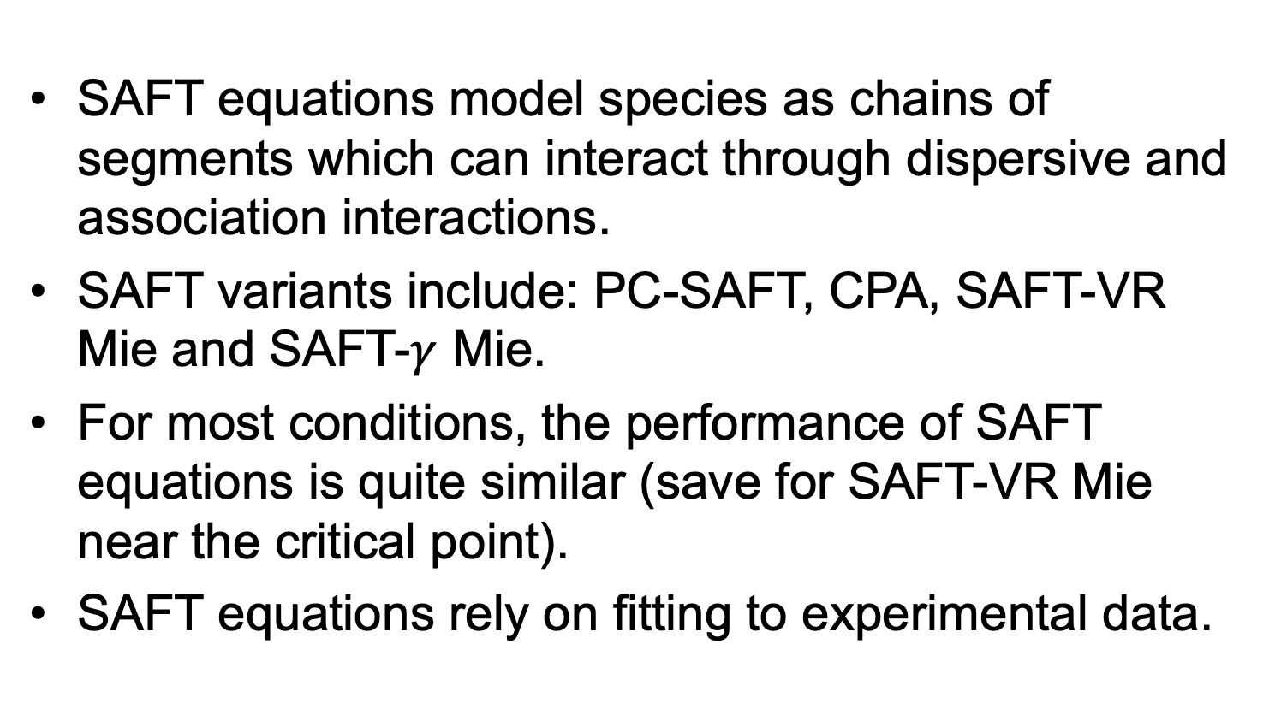
Key Points
SAFT equations model species as chains of segments which can interact through dispersive and association interactions.
SAFT variants include: PC-SAFT, CPA, SAFT-VR Mie and SAFT-$γ$ Mie.
For most conditions, the performance of SAFT equations is quite similar (save for SAFT-VR Mie near the critical point).
SAFT equations rely on fitting to experimental data.

